Slide 1
Disorders of Pancrease and Gallbladder
By
Prof.D.Methaq A.Abdalsamad

Slide 2
Disorders of Pancrease :
Acute hemorrhagic pancreatitis
Etiology:
.1Gall-stones
2.Alcohols
3.Hypercalcaemia
4.Drugs
5.Infection

Slide 3
Pathogenesis:
Pancreatic acinar cell injury
results in activation of pancreatic enzymes
causes destruction of the pancreatic parenchyma
Acute hemorrhagic pancreatitis

Slide 4
Clinical symptoms
Stabbing epigastric abdominal pain radiating to the back
Shock
Hypercalcaemia
Laboratory investigation: elevation of serum amylase and lipase

Slide 5
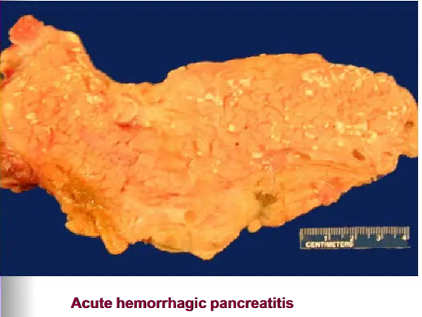
Gross pathology:
Focal pancreatic hemorrhage and liquefaction
Chalky, white yellow fat necrosis of adjacent adipose tissue

Slide 6
Microscopically:
Liquefactive necrosis of a pancreatic parenchyma.
Acute inflammation
Necrosis of blood vessels causes hemorrhage
Complication:
Acute respiratory distress syndrome (ARDS)
Pseudo cyst of pancreas
Pancreatic calcification

Slide 7
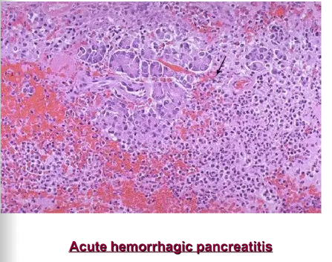

Slide 8
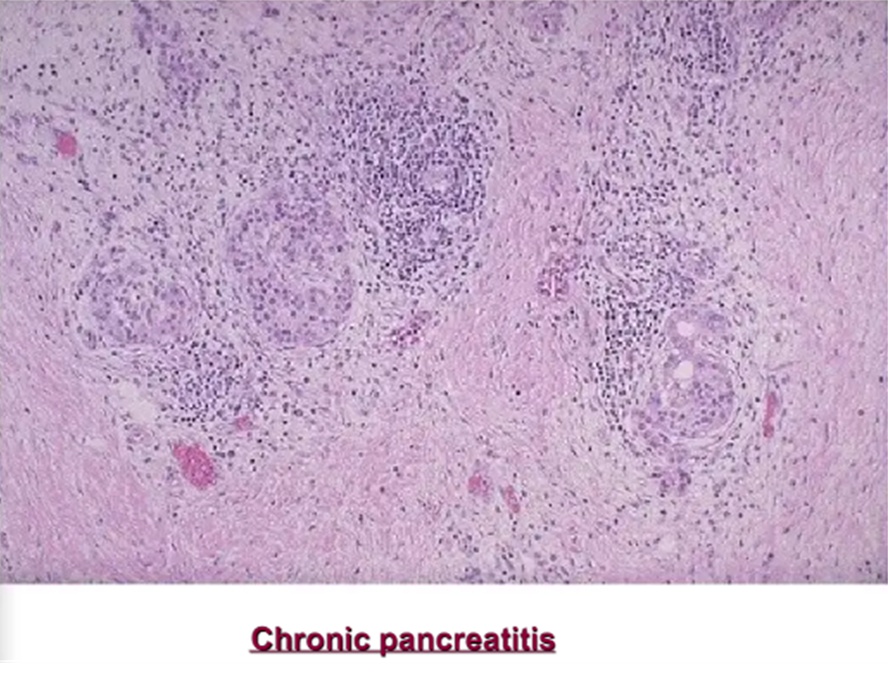
Chronic pancreatitis
Definition: Chronic inflammation, atrophy and fibrosis secondary to repeated attacks of pancreatitis
Grossly:
Firm white fibrotic pancreas
Microscopic:
Extensive fibrosis and parenchymal atrophy
Chronic inflammation

Slide 9
Clinical symptoms:
1. Abdominal pain
2. Pancreatic insufficiency
3. Pancreatic calcification
4. Pseudocyst
5. Diabetes

Slide 10
Disorder of Gallbladder
Cholecystitis:
This may be acute, chronic, or acute superimposed on chronic, and almost always occurs in association with gallstones. Its epidemiologic distribution closely parallels that of gall stones.

Slide 11
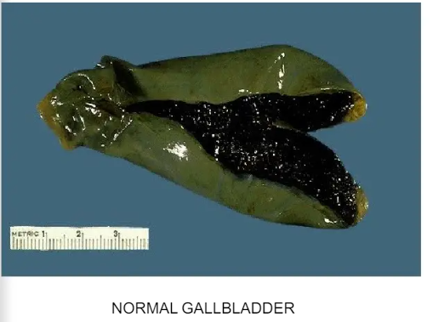

Slide 12
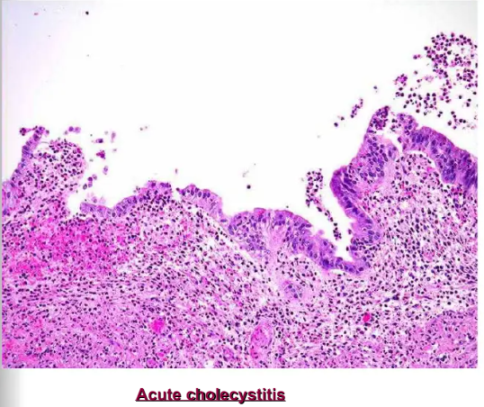

Slide 13
Chronic cholecystitis
Definition:chronic inflammation of the gallbladder may be the sequel to repeated bouts of acute Cholecystitis, it is almost always associated with gallstones .
Microscopically:
Chronic inflammation
Complication:
Calcification of the gall bladder (porcelain gall bladder)

Slide 14
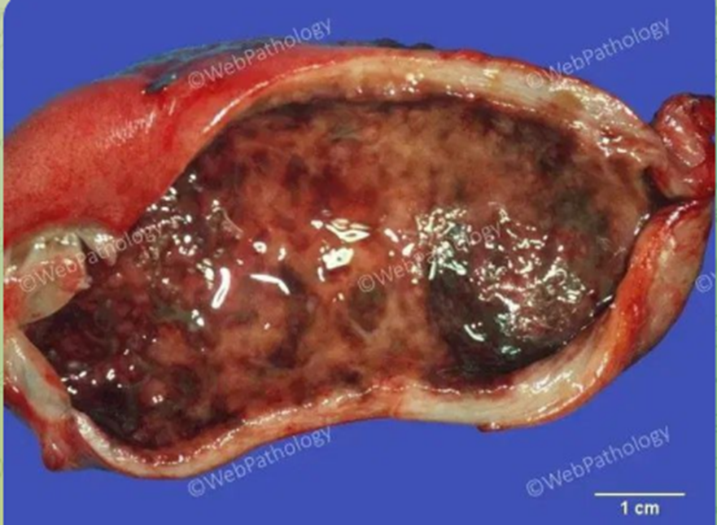
Macroscopically, the gallbladder may be normal in size or appear distended, with a normal or thickened wall. The example shown here has a slightly thickened wall and a hemorrhagic mucosa.

Slide 15
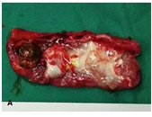
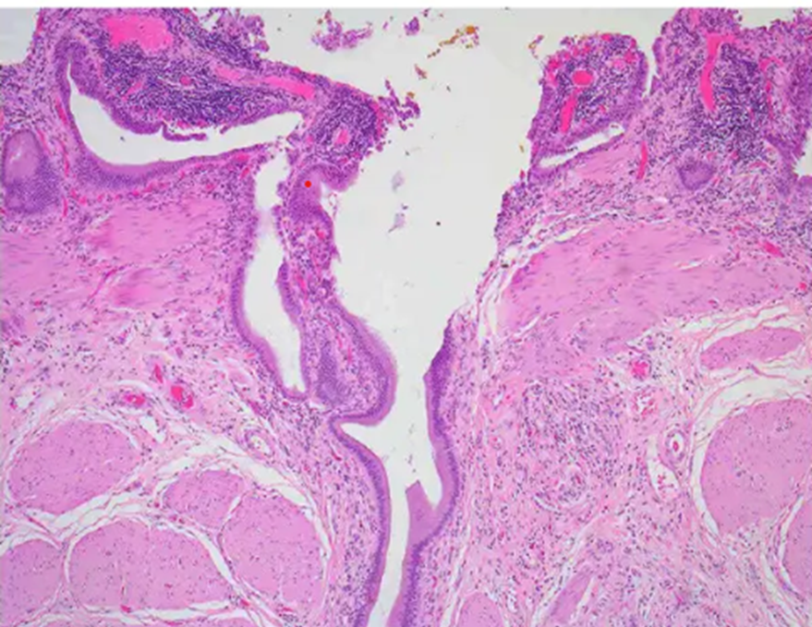
Microscopically:
Chronic inflammation
Complication:Calcification of the gall bladder (porcelain gall bladder)
B
A :The gross specimen of gallbladder ,It was attached with sticky milky jelly-like substance (arrow).
B. the gallbladder mucosa was atrophy and attaches to jelly-like substances ( black arrow) with deposition of calcium minerals ( red arrow) .

Slide 16
Cholelithiasis (Gallstones) :
is the medical term that describes the presence of gallstones in the gallbladder. The gallbladder is a small, pear-shaped organ located beneath the liver that stores bile produced by the liver. When the substances in the bile crystallize and harden, stones are formed.
Gallstones trouble up to 20% of adult populations and are mainly of two types
1. Cholesterol stones composed of crystalline cholesterol monohydrate (80%)
2. Pigment stones composed predominantly of bilirubin calcium salts (20%)

Slide 17
Causes
Increased age
Gallbladder hypomotility (i.e., bile stasis leads to precipitation of bile components; often associated with total parenteral nutrition)
Cholesterol stones: most commonly due to hypercholesterolemia, gallbladder stasis or deficiency in bile salts / acids (normally increase solubility) or phospholipids (i.e., lecithin)
Genetic predisposition
Increased estrogen (i.e., female sex)

Slide 18
Rapid weight loss can cause increased cholesterol secretion, altered bile composition, increased mucin production, hormone alterations and gallbladder stasis
Metabolic disorders: insulin resistance / diabetes (insulin resistance increases circulating cholesterol),
Medications
Exogenous female sex hormone (i.e., oral contraceptives)

Slide 19
Gross description
Gallbladders affected by cholelithiasis may appear thick walled or fibrotic and can contain 1 or multiple stones of varying size
Gallstones may be freely luminal, impacted in the cystic duct or biliary tree or embedded within the mucosa or wall
Number and aggregate size of the stones can vary, with the largest stones sometimes measuring several centimeters

Slide 20
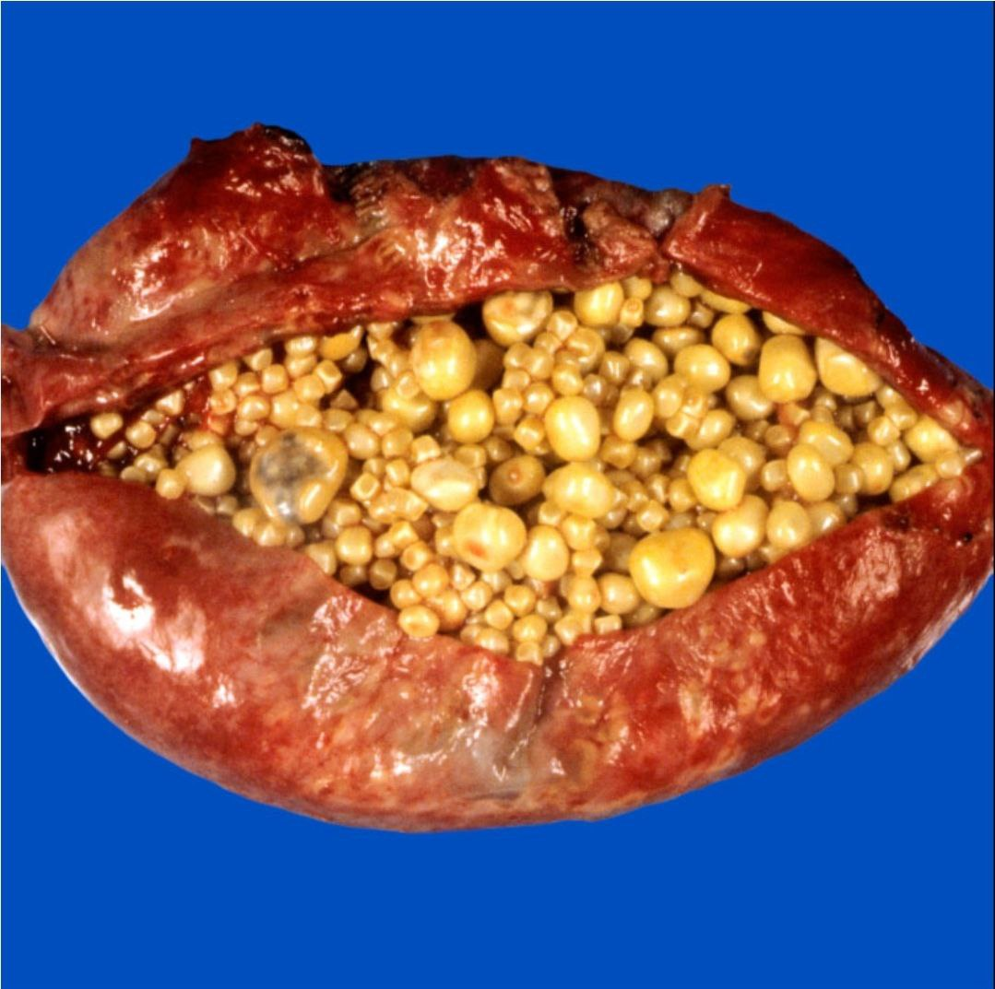
Gross lesion

Slide 21
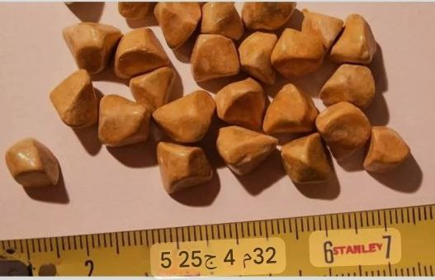
Gallstone types include
Cholesterol stones: round or polygonal, pale yellow to brown, with a firm, crystalline radial cut surface; when multiple, they may display faceted surfaces from close apposition

Slide 22
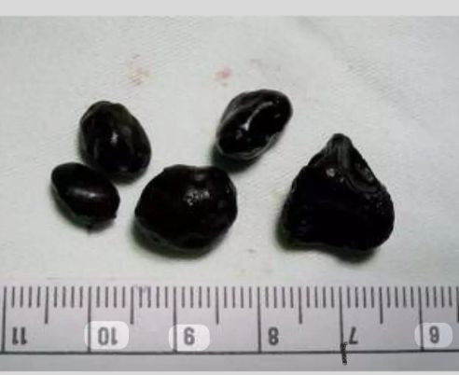
Pigment Gallstones:These are formed due to increase bilirubin in the bile and include:
Black pigment stones: typically multiple, small, hard, shiny stones with a black external surface and a laminated internal structure
Brown pigment stones: usually soft, brown and may be single or multiple

Slide 23
PATHOPHYSIOLOGY
Chemical imbalance
Decreased bile acid synthesis( dissolve lipids)
Increased cholesterol synthesis in the liver
Super saturation of bile with cholesterol
Formation of precipitates
Gall stones (Cholelithiasis)( causes injury to the wall of gallbladder)
Inflammatory changes (Cholecystitis)

